Slide 1

Module 5
Natural Language Processing
by
Jay Yee

Slide 2
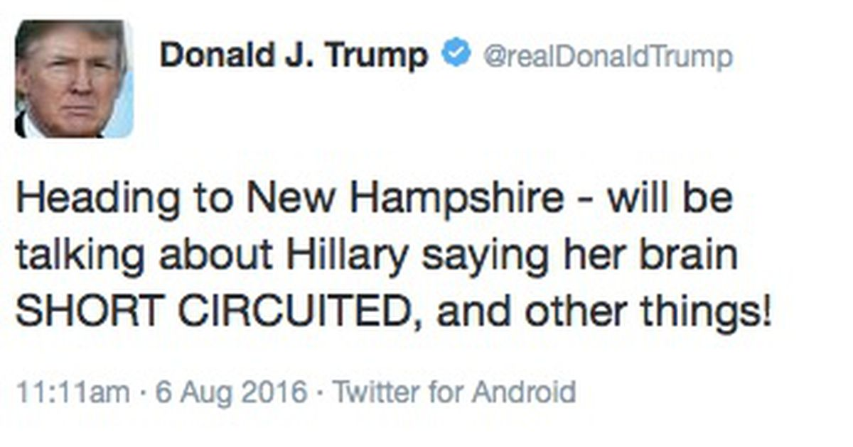
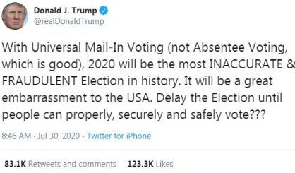
Project Background
Question:
Can we build a classifier that can predict if a tweet was made by Trump?
Process:
Create two classification models:
Use purely the contents of the tweet.
Use traditional classification models that include the tweet topic as a feature.
Dataset: Tweets from June 16, 2015 – March 25, 2017
Amount: 5,347 tweets (excludes retweets)
Donald Trump has become one of the most prolific Twitter users ever, especially during the final months of his presidency. In his final year as president, he averaged over 33 tweets per day. This became a rich source of data to analyze trends and understand patterns.

Slide 3
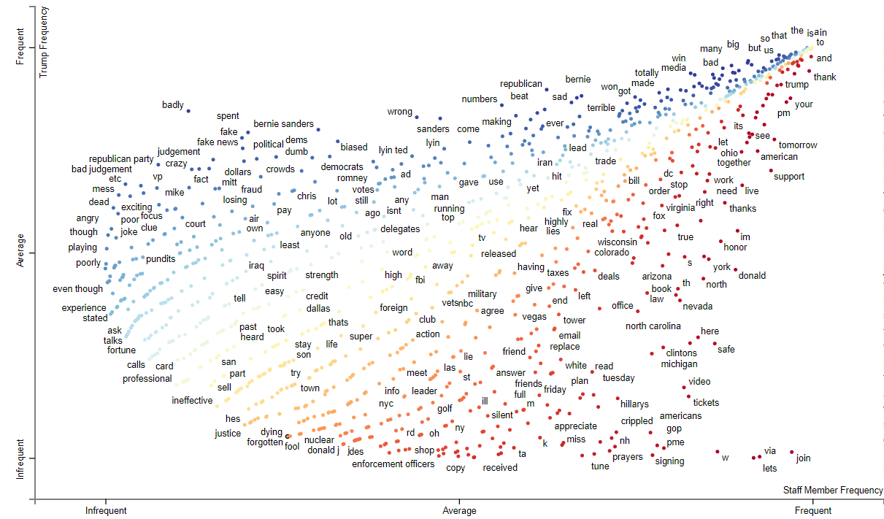
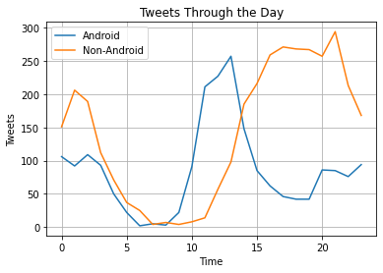
Exploratory Data Analysis
Takeaway:
AM Tweets: Trump / Android
PM Tweets: Staff Members / Non-Android
Top words from each user:
Trump: “many, bad, big, media, republican, crooked, win, or, but, bernie, badly, would, election, interviewed”
Staff: “join, via, lets, support, tomorrow, your, pm, thank, American, w, see, donald, im, live”

Slide 4
Text Preprocessing and Topic Modeling Results
Ran four topic modeling iterations
NMF and LSA models based on CountVectorizer and TF-IDFVectorizer tokenization
Above table represents top 10 topics from each model; bottom row shows # of duplicate topics (highlighted in red)
Best result: NMF Model using CountVectorizer

Slide 5
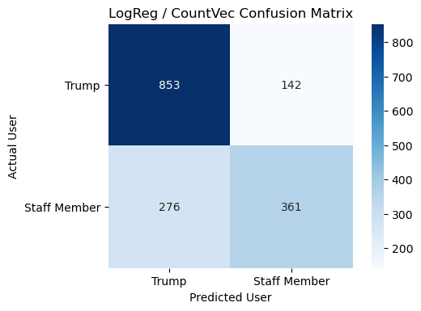
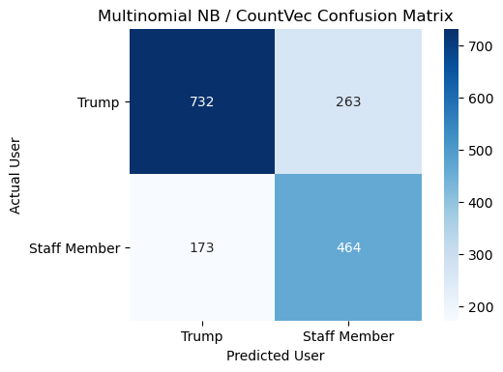
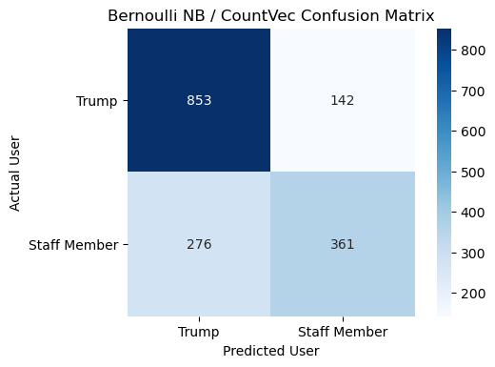
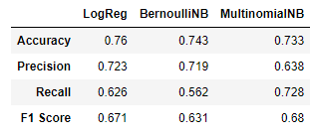
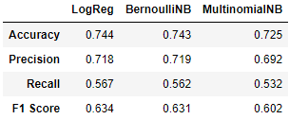
Natural Language Processing – CountVectorizer Results
Ran the doc-term matrix through three classification models: LogReg, Bernoulli NB, Multinomial NB.
Used F1 Score as measure of success.
Best result: Multinomial NB
CountVectorizer Results
TF-IDFVectorizer Results

Slide 6
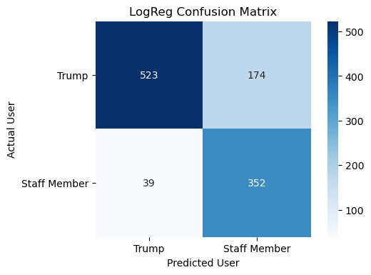
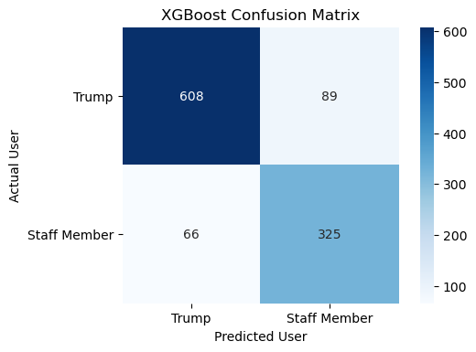
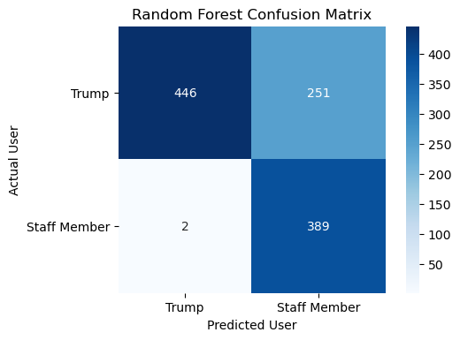
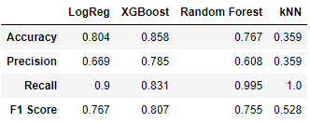
Classification Modeling - Results
Created new features and included the topic modeling as a ‘topic’ feature.
Feature Selection: 8 predictor features derived from data set that took into account time and contents of the tweet
Best Result: XGBoost

Slide 7
In Conclusion…
Next Steps:
Finetune parameters for Classification model
Build out more robust features for traditional Classification model
Expand dataset through Trump’s presidency
Identify any idiosyncrasies to Trump’s tweeting; can that be expanded to other prolific Twitter users?
Other Ideas:
Track trends and patterns through tweet content.
Create Regression models, for example:
What attributes of a tweet will garner the most engagement?
Create other Classification models, for example:
Does Elon Musk’s tweets affect $TSLA?
Can we develop a reliable model to flag fake news?

Slide 8
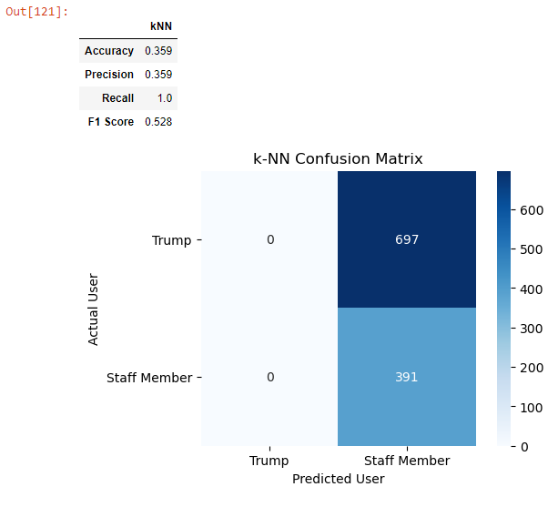
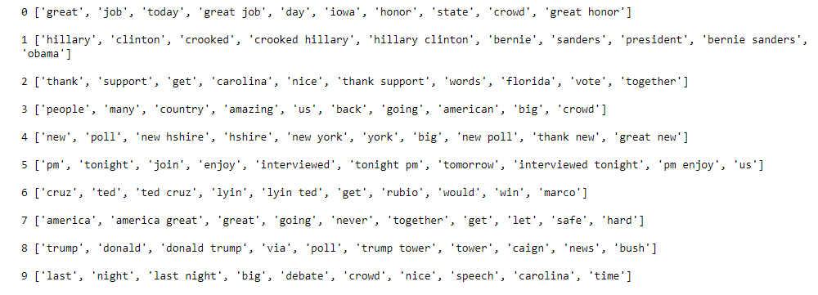
Appendix

Slide 9
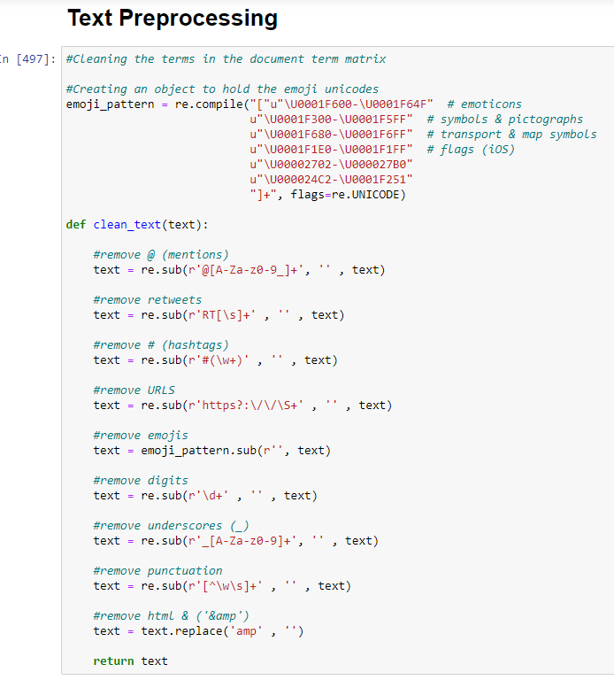
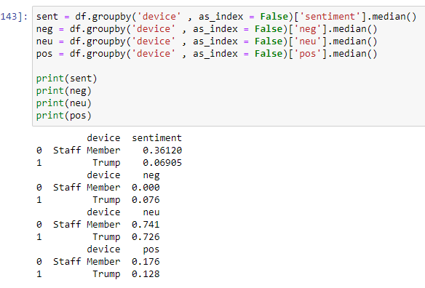
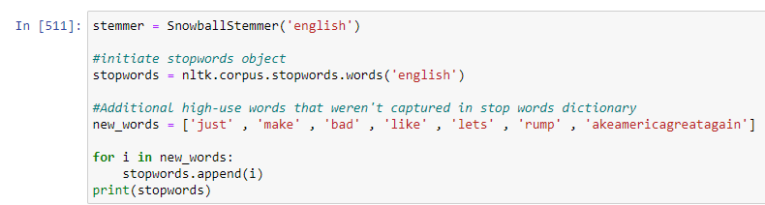
Appendix

